Slide 1
AGU 2013
IN21D-07 :: The ES-DOC Project

Slide 2
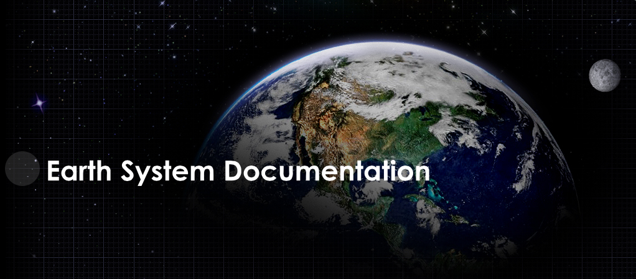


Slide 3
http://es-doc.org

Slide 4
#esdocumentation

Slide 5
Funders
IPSL (EU)
NOAA (US)
EX-ARCH (G8)
ISENES-2 (EU)

Slide 6
PI’s
Venkatramani Balaji (US - NOAA)
Cecelia DeLuca (US - NOAA)
Sébastien Denvil (EU - IPSL)
Eric Guilyardi (EU - IPSL)
Bryan Lawrence (EU - BADC)
Karl Taylor (US - PCMDI)

Slide 7
Core Team
Sylvia Murphy (US - NOAA)
Allyn Treshansky (US - NOAA)
Mark Greenslade (EU - IPSL)

Slide 8
Mission
Nurture a standards based eco-system in support of earth system documentation creation, analysis & dissemination.

Slide 9
Sub-Domains
2013
Earth System Models
Statistical Downscaling
2014
Obs4MIPs ?

Slide 10
Strategic Relevance
EXA-Scale requires quality documentation

Slide 11
Process
Transparent
Documented
Iterative
Sustainable
International

Slide 12
Services
Engage scientific community
Nurture standards, e.g. CIM
Advocacy
Governance
Dissemination
Exploitation

Slide 13
Tools
Create
Search
View
Compare
Visualize

Slide 14
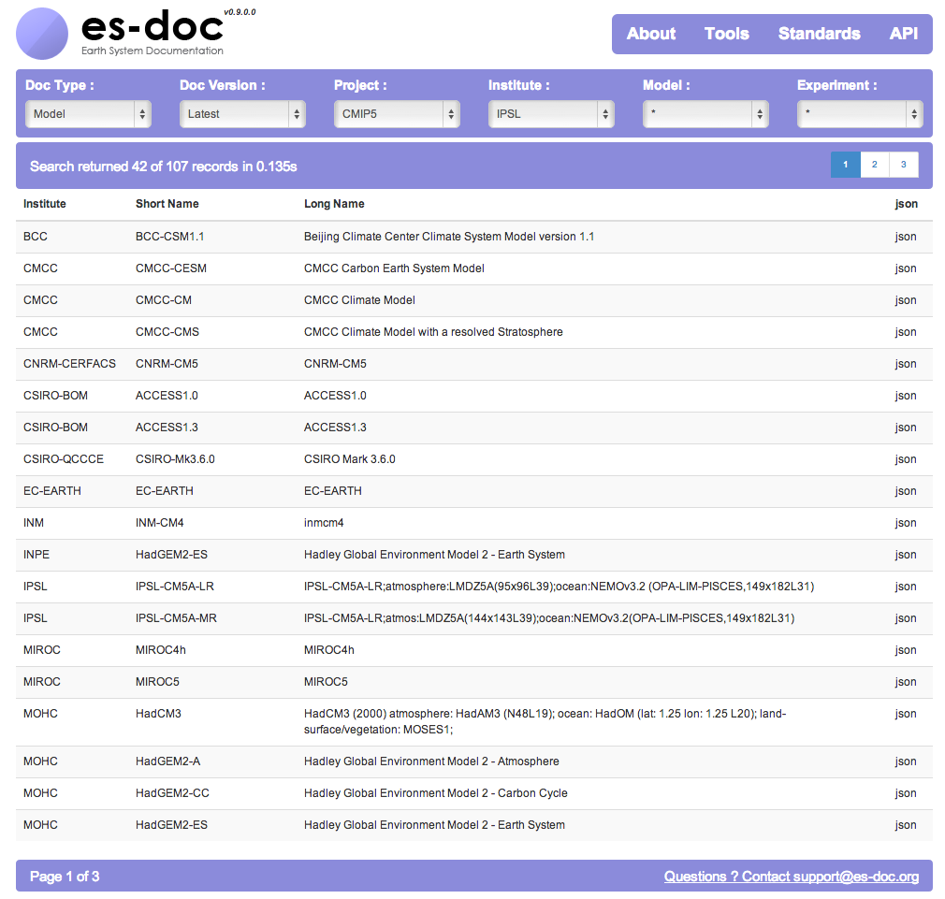

Slide 15
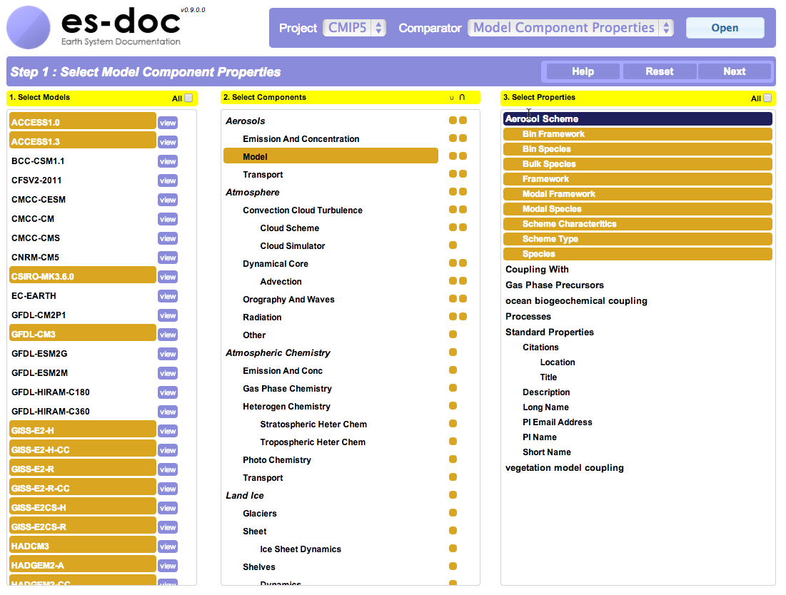

Slide 16
API
Publish
Search
Compare
Visualize

Slide 17
Publishing API Client
2013
Python
2014
C, Java

